Slide 2
Practice-based Evidence Toolkits [PETs]
Orientation Module
August 2013

Slide 3
About this Module
This module provides an orientation to Practice-based Evidence Toolkits (PETs).
You will learn:
What PETs are
Why they were developed
Key design features
How to access and navigate through PETs
Contact information and how to provide feedback

Slide 4
What are PETs?
PETs:
replace Practice Guidance Summaries (PGSs), with slight modifications made to Backgrounds (i.e. move nutrition diagnosis into the toolkits)
are a ‘one-stop-shop’ for evidence-based practice guidance
relate to a particular knowledge pathway
are organized according to the Nutrition Care Process (NCP) steps, as described by standard terminology (International Dietetics and Nutrition Terminology – IDNT)
Notes:
PEN® Backgrounds, Practice Questions and Evidence Summaries contain additional theory and nutrition content.

Slide 5
What are PETs cont’d
PET sections fall into the four NCP steps for specific nutrition related conditions/diseases:
Nutrition Assessment - with links to professional tools and calculators
Nutrition Diagnosis - include PES statements (problem, etiology, signs and symptoms)

Slide 6
What are PETs cont’d
Nutrition Intervention - include Nutrition Prescription, Goals and Key Findings & Recommendations, critical for practice guidance
4. Nutrition Monitoring and Evaluation – provide guidance for monitoring and evaluating NCP outcomes.

Slide 7
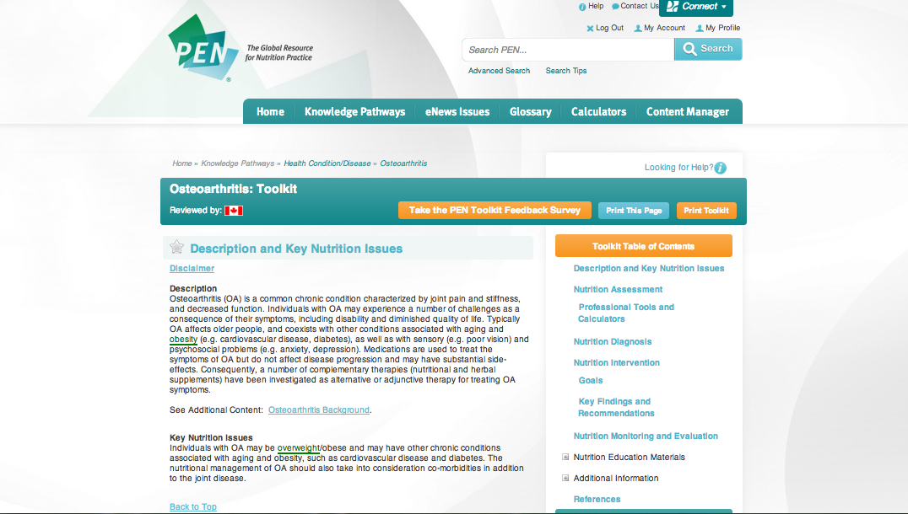

Slide 8
Why PETs vs PGSs?
User feedback, focus and pilot testing of PET prototypes revealed:
Users love the evidence-based Backgrounds and Practice Questions in PEN® -
BUT, users desired quicker access to practical guidelines and information, including practice tools such as calculators.

Slide 9
PET Design Features
To minimize scrolling, focus on NCP steps and be easy to navigate, PETs:
are presented as small “bits” of information on several different pages
have:
lots of white space
use anchor tags (to link to related information within the toolkit)
more tables and bullet points.

Slide 10
PET Design cont’d
In addition, PETs provide quick access to practical resources and tools including:
PEN client handouts
Other key peer reviewed 3rd party handouts
Practice guidelines (where available)
Calculators – BMI for adults, BMI for children, metric converters.
Notes:
Refer to next slide and picture of a Toolkit

Slide 11
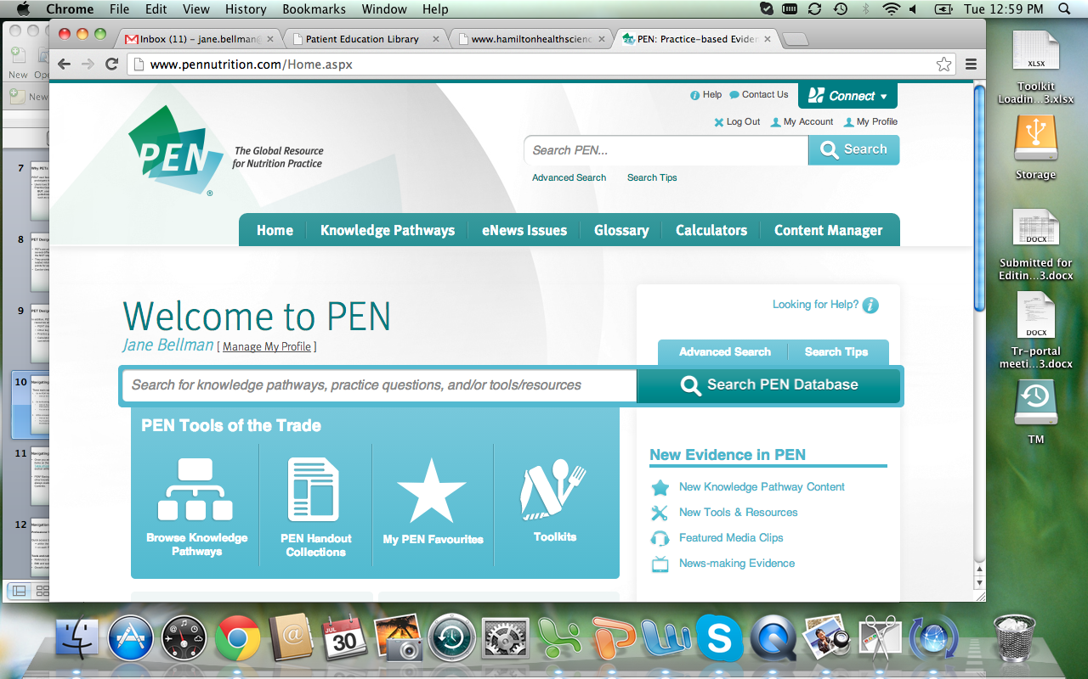
Navigating Through PETs
Three main ways to find PETs:
PEN Home page: Click on the Toolkit icon.
Knowledge Pathway Table of Contents page:
Click any of the under the Toolkit/PGS column.

Slide 12
Navigating cont’d
3. In a knowledge pathway:
Click on the “Toolkit” tab on the right hand side.
The Toolkit tab will only display as an option if the knowledge pathway has a toolkit.

Slide 13
Navigating cont’d
Once you are in a toolkit, click on any of the items in the Table of Contents (TOC) to access specific sections.

Slide 14
Navigating cont’d
You can save your most used toolkits into My Favourites on the PEN home page.
Click on the star on the left hand side of the toolkit to add it.

Slide 15
Navigating cont’d
Print or view a pdf of a page or the complete toolkit:
- Click the tabs above the toolkit TOC.
View other great PEN features:
Backgrounds, Practice Questions and
other knowledge pathway resources
are always available under the toolkit
TOC.

Slide 16
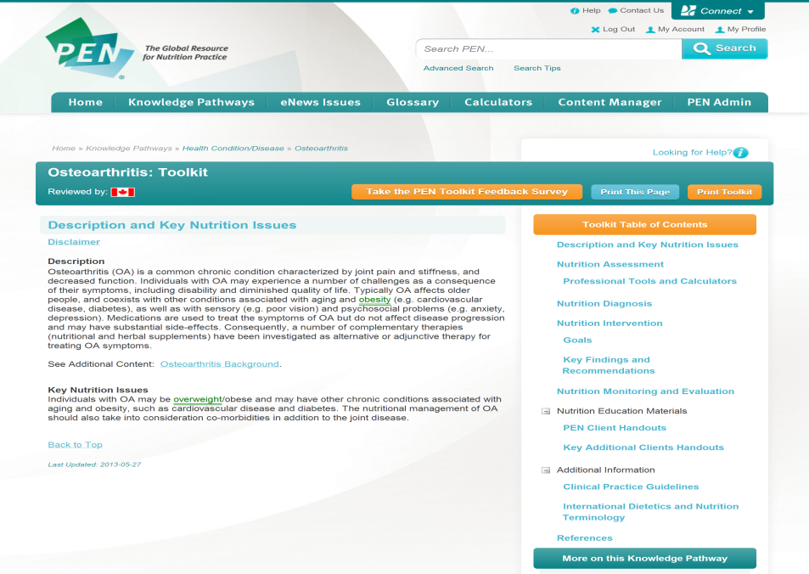
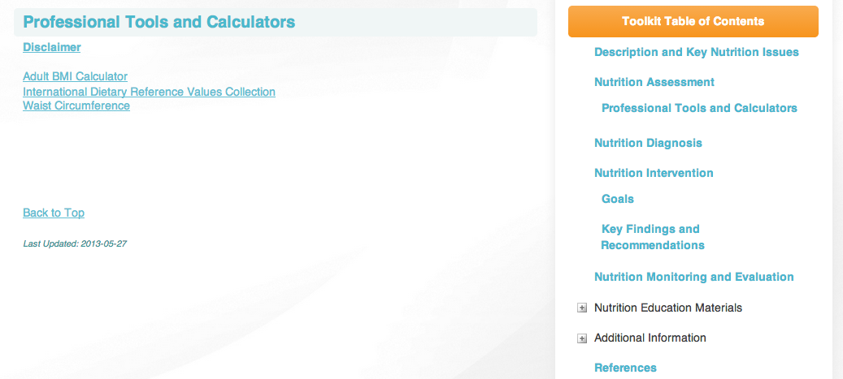
Navigation Basics cont’d
Professional Tools and Calculators
Quick access to practice calculators:
within the Toolkit Assessment section
on each PEN page on the top bar.
2 more calculators to be added in 2013-14

Slide 17
Navigation cont’d
PETs also provides quick access to specific topic related client resources.
Watch for TOC headings with a “+”. There are contents hidden underneath the heading, so be sure to click on it to see other topics!
PEN client handouts 3rd party handouts

Slide 18
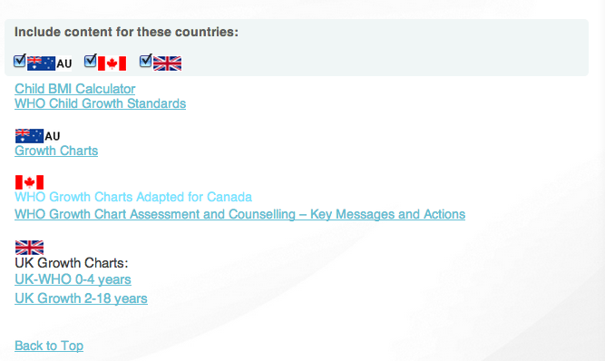
Navigation Basics cont’d
Country Flags:
Country-specific information is available for Canada,
Australia, New Zealand and the United Kingdom, and
depending on which country has reviewed the content,
it will be displayed.
Users can click the box at the top of the page to view the desired country information (or alternatively unclick the box to hide it).

Slide 19
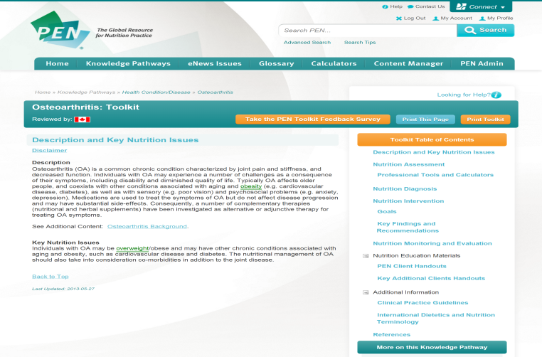
Take the PEN PET Survey
On the PEN home page.
At the top of the toolkit page.

Slide 20
Contacts:
Feedback, comments and ideas welcome!
jane.bellman@dietitians.ca
kerri.staden@dietitians.ca

